Slide 1
Wild

Slide 2
Domesticated

Slide 3
Wild

Slide 4
Domesticated

Slide 5
Wild

Slide 6
Domesticated

Slide 7
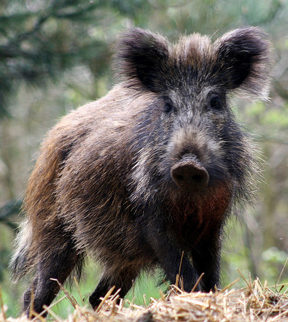
Wild

Slide 8
Domesticated

Slide 9
Wild

Slide 10
Domesticated

Slide 11
Wild

Slide 12
Domesticated

Slide 13
Wild

Slide 14
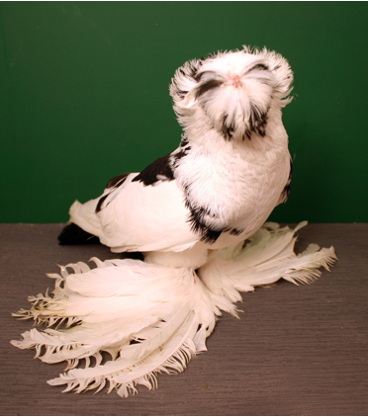
Domesticated

Slide 15
Wild

Slide 16
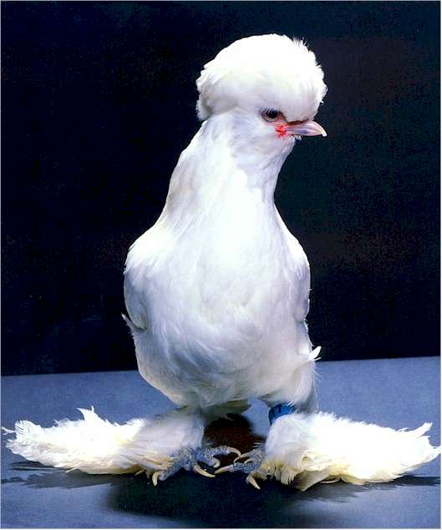
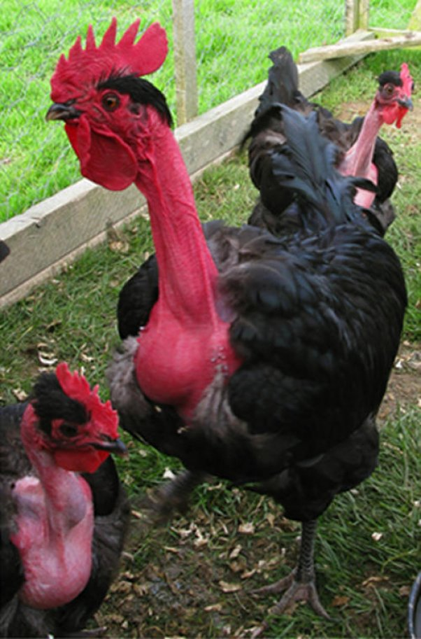
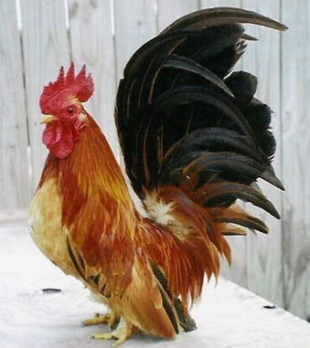
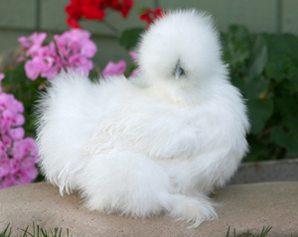
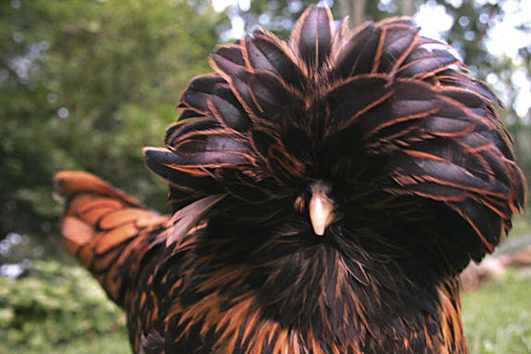
Domesticated

Slide 17
Wild

Slide 18
Domesticated

Slide 19
Domesticated

Slide 20
Domesticated

Slide 21
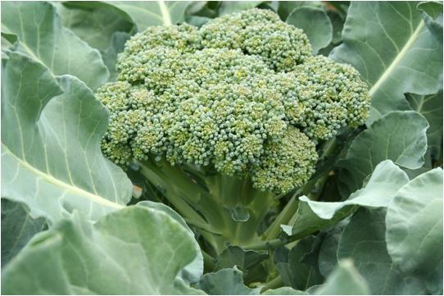
Domesticated

